Slide 1
EPA’s Refillable Container Requirements Are You Ready?
IFCA Workshop
January 20, 2011

Slide 2
Container-Containment Rule Overview
Category | Nonrefillable Containers | Refillable Containers | Repackaging Products | Container Labeling | Containment Structures
Who must comply? | Registrants | Registrants | Registrants Refillers | Registrants Users | Ag retailers Ag comm apps Ag custom bldr
Major Require-ments | - DOT container design, construction & marking standards - Dispensing capability - Standard closures - Residue removal (99.99% removal) | - DOT container design, construction & marking standards - One-way valves or tamper-evident devices - Vent, gauge & shutoff valve standards for large tanks | - Registrants & refillers comply with specified conditions - Registrants develop & provide certain information - Refillers obtain & follow information; and clean, inspect & label containers before refilling them | - Identify container as nonrefillable or refillable (all) - Statement to prohibit reuse and offer for recycling; batch code (all nonrefillables) - Cleaning instructions (some nonrefillables) - Cleaning instructions before disposal (all refillables) | - Secondary containment structures (dikes) around large tanks - Containment pads for pesticide dispensing areas - Good operating procedures - Monthly inspections of tanks & structures
Compli-ance Date | Aug 17, 2009 | Aug 17, 2011 | Aug 17, 2011 | Dec 17, 2010 Aug 17, 2011? | Aug 17, 2009

Slide 3
Which Products Must Comply?
The nonrefillable container, refillable container and repackaging requirements apply to all pesticide products except for:
Manufacturing use products (MUPs);
Plant-incorporated protectants (PIPs); and
Antimicrobial products that are exempt.
The label requirements apply to all pesticides except PIPs, pesticidal articles and pesticides in transport vehicles.
There are some specific exemptions and partial exemptions.

Slide 4
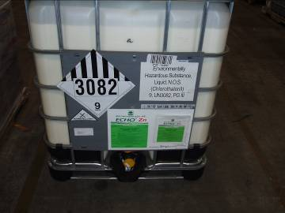
What is the difference between nonrefillable & refillable containers?
Nonrefillable container: designed & constructed for one-time use and not intended to be filled again with a pesticide for sale or distribution.
Refillable container: intended to be filled with pesticide more than once for sale or distribution.
[§165.3.]
A nonrefillable container will have a label that says: “Nonrefillable container. Do not reuse or refill this container.” These containers cannot legally be reused or refilled!

Slide 5
New Requirements in 2011
If you repackage pesticides under contract/ agreement with a registrant, you must comply with the following requirements when you repackage a pesticide (& release it for shipment) after August 16, 2011:
Operational and recordkeeping requirements regarding repackaging;
Standards for your stationary bulk tanks; and
Standards for your portable refillable containers (i.e., minibulks, IBCs).

Slide 6
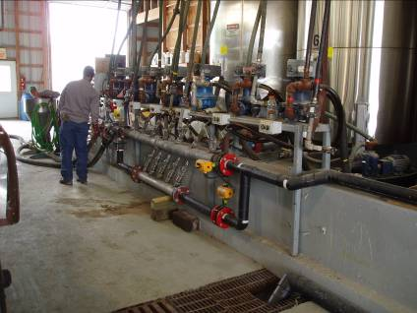
1. Repackaging Requirements
Conditions for repackaging under a registrant’s existing registration [§165.70(b)]
Registrants develop and provide certain information to each refiller: [§165.67(d), (f) & (g)]
Written contract
Refilling residue removal procedure
Description of acceptable containers
Requirements for independent (non-registrant) refillers [§165.70(e)]

Slide 7
1.A. Conditions for Repackaging
Under §165.67(b) & §165.70(b), a registrant may allow an independent refiller to repackage a pesticide under the registrant’s existing registration if:
There is no change to the pesticide formulation;
The refiller’s establishment is registered with EPA;
And the pesticide is repackaged at the establishment or at the site of an end user who intends to use/apply the pesticide
The registrant & refiller have entered into a written contract to repackage the pesticide and use the pesticide’s label;
The pesticide is repackaged only into containers that comply with the refillable container requirements; and
The pesticide is labeled, with the only changes being the net contents and the refiller’s EPA establishment number.

Slide 8
1.B. Refiller Requirements
An independent refiller must comply with all of the requirements in §165.70(e):
Register the establishment per §167.20;
Not change the formulation;
Repackage only into a refillable container on registrant’s description of acceptable containers;
Can repackage any quantity; no container size limits;
Have the following items at the facility before repackaging:
Contract + label/labeling
Registrant’s cleaning procedure and description of acceptable containers;
Identify the pesticide previously in the container;
Visually inspect the container;
(continued on next page)

Slide 9
1.B. Refiller Requirements
An independent refiller must comply with all of the requirements in §165.70(e):
Clean the container if necessary
Must be cleaned between uses unless all tamper-evident devices and one-way valves are intact and filled with the same or a very similar product;
Ensure the container is properly labeled;
Maintain records of the information from the registrant; and each time the container is refilled, record the date, serial number/code of the container; & pesticide;
Maintain records required by Part 169;
Report production as required by Part 167;
Stationary containers must meet certain standards; and
You may be required to comply with the federal containment standards.

Slide 10
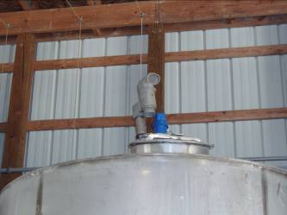
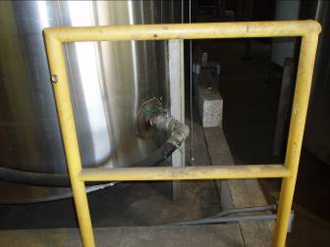
2. Standards for Stationary Tanks
Stationary tanks (holding at least 500 gallons & at the facility of a refiller operating under contract with a registrant) must:
Be durably marked with a serial number/identifying code;
Meet integrity/strength standards;
Have a vent;
Have a shut-off valve on any connection below the normal liquid level; and
Not have an external sight gauge.
[§165.45(d) & (f)]

Slide 11
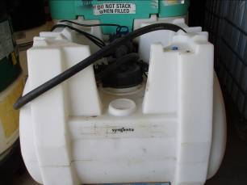
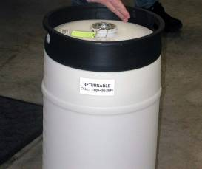
3. Portable Refillable Containers
You must repackage into portable refillable containers that:
Comply with at least DOT Packing Group III standards;
Are durably marked with a serial number/identifying code;
Have a tamper-evident device, one-way valve or both on each opening other than a vent; and
Are on the registrant’s list of acceptable containers.
[§165.45(a)-(e); §165.70(e)(3)]

Slide 12
3.A. DOT/United Nations Marking
All portable refillable containers must meet at least the DOT packing group III standards.
§165.45(a): A pesticide product that does not meet the definition of a hazardous material in 49 CFR 171.8 must be packaged in a refillable container that, if portable, is designed, constructed, and marked to comply with the requirements of 49 CF 173.4, 173.5, 173.6, 173.24, 173.24a, 173.24b, 173.28, 173.155, 173.203, 173.213, 173.240(c), 173.24(d), 173.241(c), 173.241(d), Part 178 and Part 180 that are applicable to a Packing Group III material…
§165.45(b): If it is a DOT hazardous material, must comply with applicable DOT requirements.

Slide 13
3.A. DOT/United Nations Marking
All portable refillable containers must meet at least the DOT packing group III standards. [§165.45(a) & (b)]
Generally, can determine this by the UN/DOT marking, such as: un 31HA1/Y/04/01/USA/etc.
Important: look for UN symbol and X, Y or Z
X = meets PG I stds (most stringent)
Y = meets PG II stds
Z = meets PG III stds
The DOT standards that are incorporated in §165.45(a) authorize certain “portable tanks” that comply but do not require the UN marking.
Rely on the registrant’s description of acceptable containers.
Also includes ongoing maintenance and testing (e.g., pressure test).

Slide 14
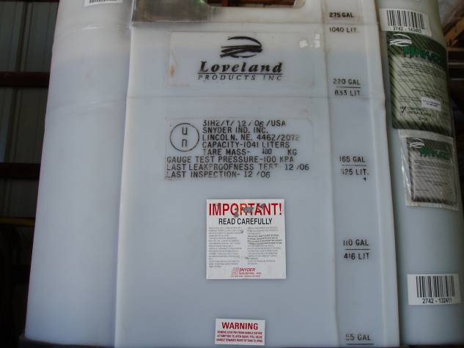
3.A. DOT Requirements

Slide 15
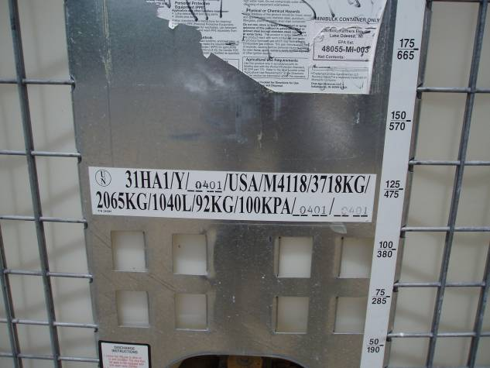
3.A. DOT Requirements

Slide 16
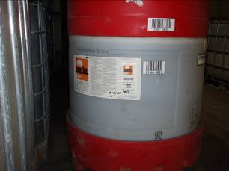
3.B. Serial Number/Identifying Mark
Each refillable container must be durably marked with a serial number or other identifying code. [§165.45(d)]
Durable marking includes an adhesive label if it’s securely attached = can reasonably be expected to remain affixed during the foreseeable conditions and period of use. [§156.10(a)(4)]

Slide 17
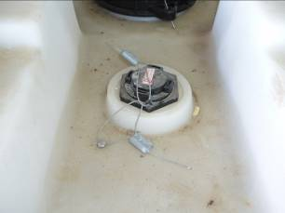
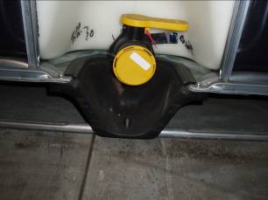
3.C. Tamper-Evident Device/One-Way Valve
For portable refillable containers holding liquid pesticides, each opening other than a vent must have a one-way valve, a tamper-evident device, or both.
A vent must be designed to minimize the amount of material that could be introduced into the container through it.
[§165.45(d)]

Slide 18
3.C. Tamper-Evident Device/One-Way Valve
One-way valve means a valve that is designed and constructed to allow virtually unrestricted flow in one direction and no flow in the opposite direction, thus allowing the withdrawal of material from, but not the introduction of material into, a container.
Tamper-evident device means a device which can be visually inspected to determine if a container has been opened.
[§165.3]

Slide 19
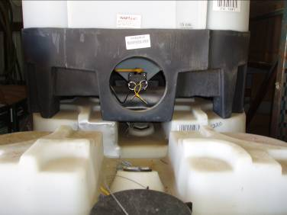
3.C. Tamper-Evident Device/One-Way Valve
The valve at the bottom of this minibulk is not a one-way valve. The end user has to break the tamper-evident device to remove pesticide from the minibulk through this valve.
This minibulk complies with the refillable container regs; it has a tamper-evident device.
However, when the minibulk is returned, the refiller must clean the minibulk, even if he is refilling it with the same pesticide product. [See§165.70(g) & (h).]

Slide 20
3.D. Registrant’s Description of Acceptable Containers
A refiller must repackage pesticide only into a refillable container that is identified on the description of acceptable containers for that pesticide product provided by the registrant.
[§165.70(e)(3)]

Slide 21
Key New Requirements for Refillers
Repackage only into compliant refillable containers. For portable containers, this means the container:
Is DOT compliant;
Is marked with a serial number/identifying code;
Has tamper-evident devices and/or one-way valves; and
Is on the registrant’s description of acceptable containers.
Clean container between uses unless all tamper-evident devices & one-way valves are intact and you are refilling with the same or a very similar product.
Get the cleaning procedure & description of acceptable containers from the registrant for each product.
For each refill, record the date, serial number/code of container; and pesticide.

Slide 22
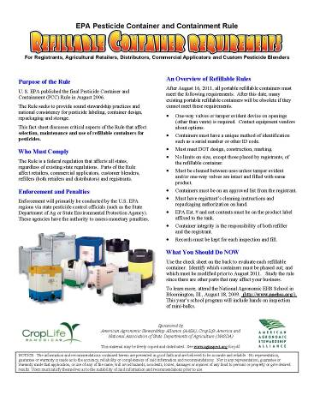
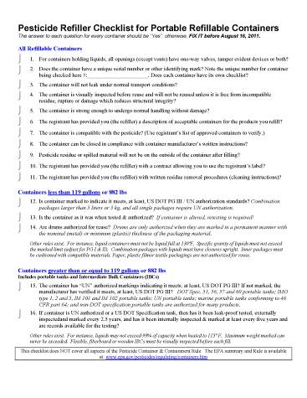
Portable Refillable Containers: Checklist

Slide 23
Important !!!

Slide 24
Service Containers
Situation: A retailer fills a refillable 15 gallon shuttle (properly labeled, etc...) with a pesticide from a 110 gallon mini-bulk. This "dispensing" occurs inside a warehouse in an area well away from any doors or walls. The 15 gallon shuttle is then transported to the field and poured into a spray rig and subsequently sprayed on a farmer's field. The retailer is paid for the pesticide and paid for the spray application.

Slide 25
Service Containers
In this case -- where the applicator is the one who transfers the pesticide for the purposes of that applicator applying the pesticide -- the 15-gallon shuttle is considered a "service container."
A service container is defined as "any container used to hold, store, or transport a pesticide concentrate or a pesticide use-dilution mixture, other than the original labeled container in which the product was distributed or sold, the measuring device, or the application device."

Slide 26
Service Containers
EPA does not currently regulate service containers although we do believe that it is a good management practice to ensure that the contents of service containers are identified and that the label of a pesticide product that is in a service container is available to the person handling and/or applying the pesticide.

Slide 27
Service Containers
However, if the retailer fills the 15-gallon shuttle, transports it to the field and the farmer (or someone else) applies the pesticide, the situation is different. In this case, the 15-gallon shuttle is a "refillable container" that is regulated by the container-containment regulations. (The regulations define "refillable container" as a container that is intended to be filled with pesticide more than once for sale or distribution.")

Slide 28
Service Container
In this case, the "dispensing" does meet the criteria in §165.82(a)(4) of "Agricultural pesticides are dispensed from any other container for the purposes of refilling a refillable container for sale or distribution" because the 15-gallon shuttle is being used to sell or distribute the pesticide and because the 110-gallon minibulk is "any other container", i.e., a container other than a 500-gallon stationary pesticide container or a transport vehicle.

Slide 29
Service Containers
In addition, the 15-gallon shuttle must comply with the refillable container requirements in the container regulations (after August 16, 2011) and must be properly labeled in compliance with EPA regulations

Slide 30
Service Containers Southern Crop Production Assn.
HEADLINE >= 121 Gal BASF RQ, ENVIRONMENTALLY HAZARDOUS SUBSTANCES, LIQUID, N.O.S. (NAPHTHALENE), 9, UN3082, PG III, ERG 171
QUADRIS RIDOMILGOLDSL{RIDOMIL} >= 119, < 3500 Gal SYNG COMBUSTIBLE LIQUID, N.O.S. (TETRAHYDROFURFURYL ALCOHOL), NA1993, PG III, ERG 128

Slide 31
For More Information
Environmental Protection Agency (EPA)
http://www.epa.gov/pesticides/regulating/containers.htm
Nancy Fitz, 703-305-7385; fitz.nancy@epa.gov
American Agronomic Stewardship Alliance (AASA)
http://www.aginspect.org/USEPA.html
CropLife America (CLA)
http://www.croplifeamerica.org & www.croplifefoundation.org
Mid America CropLife Association (MACA)
http://www.maca.org/edu
Pesticide Stewardship: See Container Handling for inspection video
http://pesticidestewardship.org/Pages/default.aspx
State Inspector Training
http://pirt.pested.psu.edu/resources

