Slide 1
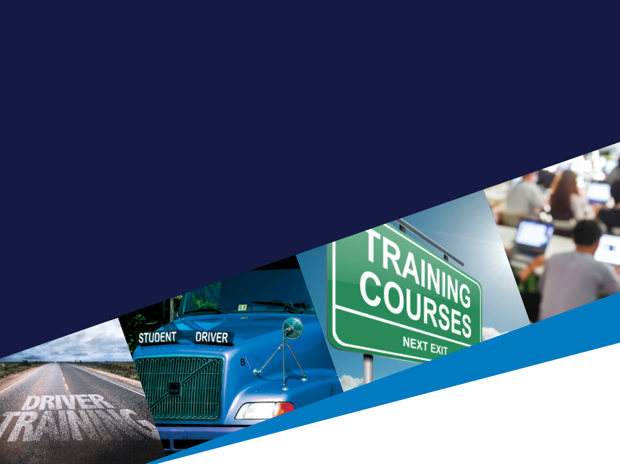

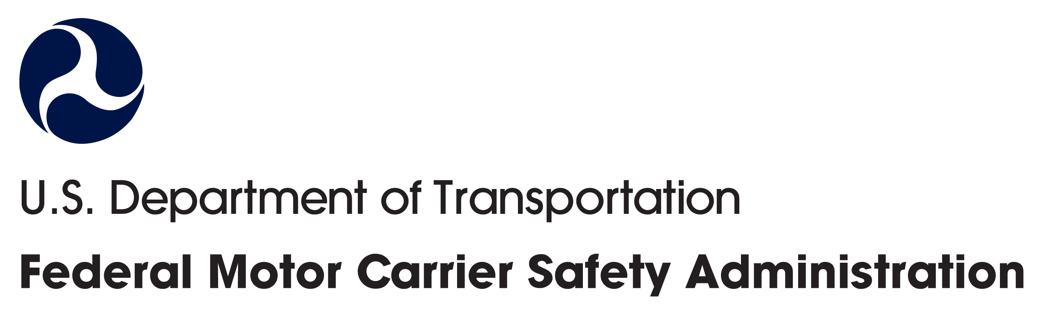
MINIMUM TRAINING REQUIREMENTS FOR
Entry-Level Commercial Motor Vehicle Operators
Illinois Fertilizer & Chemical Association
7/13/2021

Slide 2
Agenda
1
THE ELDT FINAL RULE
4
TRAINING REQUIREMENTS
What does it require of CDL applicants and training providers?
What training must entry-level drivers complete?
2
THE TRAINING PROVIDER REGISTRY
5
TRAINING PROVIDER REQUIREMENTS
Once operational, how will CDL applicants, training providers, and States be required to use it?
What do the ELDT regulations require of training providers?
3
DRIVER REQUIREMENTS
6
COUNTDOWN TO ELDT
What do the ELDT regulations require of driver-trainees?
What should training providers do now to prepare for February 7, 2022?

Slide 3
The ELDT
Final Rule

Slide 4
The Entry-Level Driver Training (ELDT) final rule
Published in 2016, mandated by MAP-21.
Set a Federal standard for mandatory training of
entry-level drivers.
  Establishes minimum requirements entry-level driver training providers must meet.
  States may have requirements that exceed Federal requirements.
Established need for the Training Provider Registry.
Compliance Date: February 7, 2022.
Notes:
Note: The EDLT final rule was amended in March 2019 to include a new Class A CDL theory instruction upgrade curriculum. This was intended to reduce the training time and costs incurred by any Class B CDL holder upgrading to a Class A CDL.
In March 2020, FMCSA extended the Entry-Level Driver Training Final Rule compliance date to February 7, 2022.

Slide 5
How will ELDT improve safety on our Nation’s roads?
Ensures that only qualified drivers receive a new CDL, or a CDL upgrade, or S, P, or H endorsement.
Sets a national baseline for entry-level driver training.
Identifies standards that training providers must meet.
Gives States information they need at critical safety checkpoints.
Further ensures that drivers operate commercial motor vehicles (CMVs) safely and meet their operational responsibilities.
The Training Provider Registry ensures that these lifesaving requirements are met.
Notes:
The Training Provider Registry will be a critical piece of the Entry-Level Driver Training Program. By receiving and retaining driver certification information from training providers and relaying it to States, the Training Provider Registry will ensure that the requirements of the Entry-Level Driver Training (ELDT) regulations are met.

Slide 6
What do the ELDT regulations require of entry-level drivers?

Slide 7
Entry-Level Drivers – Who is Covered?
The ELDT regulations §380.609 establish new minimum training standards for entry-level drivers. This includes individuals applying for:
A Class A or Class B commercial driver’s license (CDL) for the first time
An upgrade of an existing Class B CDL to a Class A CDL
A hazardous materials (H), passenger (P), or school bus (S) endorsement for
the first time
Notes:
The ELDT regulations established Federal minimum training requirements for entry-level drivers. Who is considered an entry-level driver? [ read slide ]

Slide 8

ELDT Applicability
ELDT Compliance Date
February 7, 2022
Drivers holding a CLP prior to the compliance date may obtain a CDL without completing entry-level training.
If the CLP obtained prior to the compliance date, or renewed CLP, expires prior to obtaining a CDL, the driver would be subject to ELDT requirements for Class A or Class B CDL.
If a driver holds S, P, or H endorsements prior to the compliance date, the driver is not subject to the ELDT requirements for the endorsement(s).
Drivers who obtain a CLP on or after the compliance are subject to ELDT regulations for CDLs.
Drivers who apply for a S, P, or H endorsement after the compliance date are subject to ELDT requirements for those endorsements.
Notes:
Refer to:
§380.603 Applicability.
(a) The rules in this subpart apply to all entry-level drivers, as defined in this subpart, who intend to drive CMVs as defined in §383.5 of this chapter in interstate and/or intrastate commerce, except:
(1) Drivers excepted from the CDL requirements under §383.3(c), (d), and (h) of this chapter;
(2) Drivers applying for a restricted CDL under §383.3(e) through (g) of this chapter;
(3) Veterans with military CMV experience who meet all the requirements and conditions of §383.77 of this chapter; and
(4) Drivers applying for a removal of a restriction in accordance with §383.135(b)(7).
(b) Drivers issued a Class A CDL, Class B CDL, or a passenger (P), school bus (S), or hazardous materials (H) endorsement before February 7, 2022, are not required to comply with this subpart pertaining to that CDL or endorsement.
(c)(1) Individuals who obtain a CLP before February 7, 2022, are not required to comply with this subpart if they obtain a CDL before the CLP or renewed CLP expires.
(2) Individuals who obtain a CLP on or after February 7, 2022, are required to comply with this subpart.
(3) Except for individuals seeking the H endorsement, individuals must complete the theory and BTW (range and public road) portions of entry-level driver training within one year of completing the first portion.

Slide 9
Driver Requirements
Entry-level drivers must complete the applicable training from a training provider that has registered with FMCSA.
  Registered training providers will be listed on the Training Provider Registry website (public listing coming fall 2021).
Training must be completed prior to taking a CDL skills test or, if applying for the H endorsement, knowledge test.
Whether or not a driver is subject to the ELDT regulations is determined by when they obtained their commercial learner’s permit (CLP) or any pre-existing endorsements.
Notes:
Drivers will use the public list on the Training Provider Registry website to search for a training provider. Drivers will contact the training provider and secure their services outside of the Clearinghouse.

Slide 10
Which drivers are NOT subject to ELDT?
The rule does not apply to:
  Drivers who held a comparable CDL prior to ELDT requirement
  Individuals not required to have a CDL per State waivers allowed by §383.3
  Individuals from whom States have waived the CDL skills test under 49 CFR 383.77 (military waivers)
  Applicants who obtain a CLP before February 7, 2022, so long as they obtain a CDL before the CLP or renewed CLP expires.
  Removing the restriction from a current CDL
  Reinstating a CDL after a period of disqualification
Notes:
Drivers will use the public list on the Training Provider Registry website to search for a training provider. Drivers will contact the training provider and secure their services outside of the Clearinghouse.

Slide 11
Drug and Alcohol Clearinghouse
CLP and CDL drivers are subject to the DACH before driving on a public road
Therefore, students must be registered with the DACH before driving on a public road with a negative result 30 days before the on the road training
If employed by a carrier, then they will do drug testing through their carrier
If an independent student, they must register as employer and driver in order to perform the query required
Notes:
Drivers will use the public list on the Training Provider Registry website to search for a training provider. Drivers will contact the training provider and secure their services outside of the Clearinghouse.

Slide 12
What are the ELDT training requirements?

Slide 13

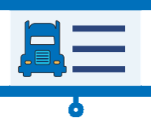
Training Requirements
Entry-level drivers must receive training and demonstrate proficiency in the following areas:
THEORY TRAINING | BEHIND-THE-WHEEL (BTW) TRAINING
Lectures, demonstrations, computer-based, online learning, etc. May use a simulator No minimum number of hours; trainees must score at least 80% on assessment Training topics include: Basic Operation Safe Operating Procedures Advanced Operation Procedures Vehicle Systems and Reporting Malfunctions Non-Driving Activities (e.g., Hours of Service) | Actual operation of a CMV Takes place on a range or public road May not use a simulator to meet requirements No minimum number of hours, training provider will determine driver’s proficiency Basic vehicle control skills and mastery of basic maneuvers

Slide 14
Training Requirements (continued)
Theory and BTW trainings may be delivered by different training providers.
  Both training providers must be registered/listed on the Training Provider Registry.
  Both training providers would separately submit driver training information.
BTW range and BTW public road trainings must be provided by the same training provider.
Driver-trainees must complete both the theory and BTW portions of training within one year of each other.
Notes:
Note that drivers may complete theory training and behind-the-wheel training with separate training providers.
Because of this, the training providers must submit the driver training certification information when the theory training program is complete, or when the behind-the-wheel training program is complete, rather than wait until the driver has completed all courses in a curriculum.

Slide 15
Training Requirements (continued)
BTW Public Road
Instructors must cover all topics listed and “determine and document that each driver-trainee has demonstrated proficiency in all elements of the BTW curriculum unless otherwise noted.”
  See Appendices A and B to Part 380.
Does not allow for “test outs” of skills training on either range or public road.

Slide 16
Additional State Training Requirements
Applicable ELDT Illinois Regulations
  Allow for CDL Employers to train own drivers only
  Offering training for other drivers requires compliance with the state regulations.
    https://ilga.gov/commission/jcar/admincode/092/09201060sections.html

Slide 17
The Training Provider Registry

Slide 18
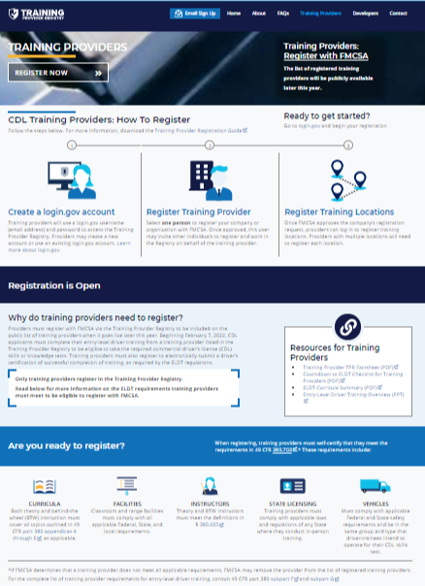
The Training Provider Registry
This FMCSA web system will:
  List training providers eligible to provide entry-level driver training.
  Retain a record of drivers that have successfully completed entry-level driver training.
  Provider Registry now available for entities to register.
Notes:
What is the Training Provider Registry?
The Training Provider Registry is a new FMCSA web system that will:
Contain the list of all entities that register with FMCSA and self-certify they meet the requirements for being entry-level driver training providers.
Retain a record of drivers that have successfully completed entry-level driver training.

Slide 19




How does the Training Provider Registry support ELDT?
Search
DRIVER
selects registered training provider from list on Training Provider Registry, completes training
Submit
TRAINING PROVIDER electronically submits driver training data to Training Provider Registry
Retain
FMCSA
retains driver data in Training Provider Registry
Retrieve
STATE
retrieves driver data from Training Provider Registry
Notes:
Here’s a quick overview of how driver training certification information gets to the Training Provider Registry, and what happens to it.

Slide 20
ELDT and the Training Provider Registry (continued)
CDL applicant searches the list of training providers on the Training Provider Registry website.
CDL applicant contacts the training provider and secures their services outside the Training Provider Registry, and successfully completes required training.
Search

Slide 21
ELDT and the Training Provider Registry (continued)
Training provider submits driver training certification information to FMCSA electronically via the Training Provider Registry.
Driver information must be submitted by midnight of the second business day after the driver-trainee completes the training.
Must be done for each student when that student completes a training program.
Submit

Slide 22
ELDT and the Training Provider Registry (continued)
FMCSA will retain the driver training certification information securely in the Training Provider Registry.
Retain

Slide 23

ELDT and the Training Provider Registry (continued)
The State, prior to administering the relevant skills or knowledge test, must use information from the Training Provider Registry to verify that the driver has competed required training.
Retrieve
Notes:
Because the information is coming from the Training Provider Registry, and only registered training providers can submit driver data into the system, this retrieval confirms that the driver completed their training with a registered training provider.
Only training providers who are registered with FMCSA will be able to submit driver training certification information.
To help make sure drivers only arrive for their test once they are eligible, FMCSA will also offer a feature on the Training Provider Registry that will allow the driver to view his or her own record on the Training Provider Registry website. However, States may only accept driver training certification information from the Training Provider Registry to determine if a driver is eligible for the applicable skills or knowledge test.

Slide 24
What do the ELDT regulations require of training providers?

Slide 25
What is a training provider?
An entity that is listed on the FMCSA Training Provider Registry.
  Training schools
  Educational institutions
  Rural electronic cooperatives
  Motor carriers
  State/local governments
  School districts
  Joint labor management programs
  Owner-operators
  Individuals
May include:
Notes:
What is FMCSA’s definition of a training provider? [ read screen ]

Slide 26
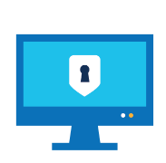



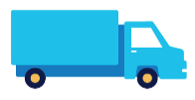

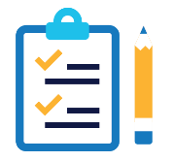

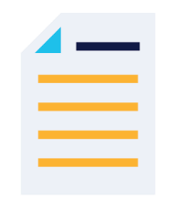
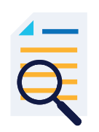
Training Provider Requirements
REGISTRATION
CURRICULA
INSTRUCTORS
FACILITIES
VEHICLES
STATE LICENSING
ASSESSMENTS
TRAINING CERTIFICATION
DOCUMENTATION
FMCSA AUDITS
For full training provider requirements, see 49 CFR part 380 subparts F & G.
Notes:
When you register on the Training Provider Registry, you will have to certify that you comply with all Federal requirements, and applicable State requirements in the States where you conduct training.

Slide 27
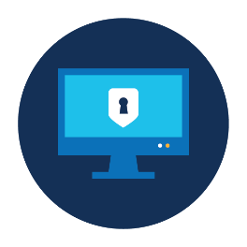
Registering with FMCSA
► For more information: § 380.703
To be authorized to provide entry-level driver training, training providers must register with FMCSA.
During registration, training providers must self-certify that they meet all applicable Federal and State requirements.
Only registered training providers will:
  Be listed on the Training Provider Registry website (publicly viewable in late 2021).
  Be able to submit driver training certification information to FMCSA (beginning on February 7, 2022).
Training providers are required to register even if they do not provide training to the general public.
  Providers may omit their contact information from the public list.

Slide 28

Curricula
Training providers must cover all topics described in 49 CFR part 380 appendices A through E, as applicable
There is no required minimum number of instruction hours.
Separate training providers may deliver the theory and behind-the-wheel (BTW) portions of the training, but both portions of BTW training must be delivered by the same training provider.
Driver-trainees must complete both the theory and BTW portions of training within one year of each other.
  Except for individuals seeking the H endorsement
A simulation device cannot be used for BTW instruction, but can be used as part of theory instruction.
Download the ELDT Curricula Summary for an overview of requirements..

Slide 29

Instructors
► For more information: §§ 380.713, 380.605
Theory and BTW instructors must hold a CDL of the same (or higher) class and with all endorsements necessary to operate the CMV for which training is to be provided.
They must also have either:
  At least two years of experience driving a CMV requiring a CDL of the same (or higher) class and/or the same endorsement; or
  At least two years of experience as a behind-the-wheel CMV instructor.
  If an instructor’s CDL has been cancelled, suspended or revoked due to offenses identified in §383.51, the instructor is prohibited from teaching for two years following the date his/her CDL is reinstated.
Notes:
For instructors, 2 years is the magic number to remember. Instructors must hold a CDL of the same of higher class with all the necessary endorsements for the type of training provided, and must have:
At least 2 years experience driving the type of CMV for which driving is being provided, or
At least 2 years experience as a BTW CMV instructor.
If a license is cancelled, suspended, or revoked. The instructor cannot provide training until at least 2 years have passed since the CDL was reinstated.

Slide 30
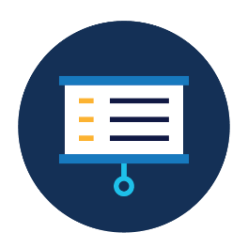
Facilities
► For more information: § 380.709
  Classroom and range facilities must comply with all applicable Federal, State, and/or local statutes and regulations.
    “Range” means an area that:
      Is free of obstructions;
      Has adequate sight lines; and
      Enables the driver to maneuver safely and free from interference from other vehicles and hazards.
    Training providers may conduct BTW range training in any area that meets the three above requirements. They are not required to maintain or rent a private facility or space.
    If range training is conducted in publicly accessible area, all CLP requirements also apply.
Notes:
Note that FMCSA doesn’t have any specific facility requirements, but the Dept. of Labor (OHSA) and Dept. of Education, as well as other agencies may regulate facilities. Training providers are responsible for knowing and complying with all applicable regulations.

Slide 31
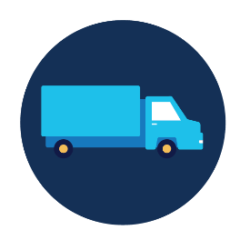
Vehicles
► For more information: §§ 380.711, 392, 393, 396
Vehicles must comply with applicable Federal and State safety requirements.
Vehicles must be in the same group and type that driver-trainees intend to operate for their CDL skills test.
Notes:
FMCSA vehicle requirements can be found in parts 392, 393, and 396.

Slide 32

State Licensing
► For more information: § 380.703
Training providers must be licensed, certified, registered, or authorized by the State where the training is conducted, as applicable.
  Note: Some States may not have instructor certification requirements for entry-level driver training providers.
If a training provider offers theory instruction only online, the State licensing requirements do not apply.
Notes:
Note that while State licensing requirements do not apply to providers that only provide theory training online. Online theory trainers must still comply with applicable Federal and State curricula requirements in the States where training is conducted.

Slide 33
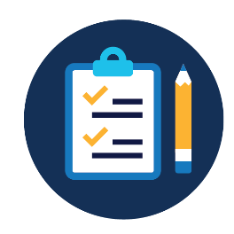
Assessments
► For more information: § 380.725
Theory Training
Training providers must use assessments (in written or electronic format) to determine trainees' proficiency with all units in the theory curriculum.
Students must earn a minimum overall score of 80 percent.
BTW Training
Training instructors must evaluate and document a trainee's proficiency in BTW skills.
Training instructors must document the total number of clock hours each trainee spends to complete the BTW curriculum, but there is no minimum number of training hours required.

Slide 34

Driver Training Certification
Training providers are not required to submit training certification information until February 7, 2022 and thereafter
The following training certification information must be submitted to the Training Provider Registry by midnight of the second business day after each student completes training:
  Driver-trainee name, date of birth, and license/permit number and State of issuance.
  CDL class/endorsement and type.
  Specifics about the type of training completed (for example, theory or BTW).
  Score on written theory assessment (if applicable).
  Total number of clock hours spent BTW (if applicable).
  Date of successful completion of training.
Notes:
The ELDT regulations require that training providers submit information to certify that drivers have completed a training course that meets ELDT standards by midnight of the second business day after each student complete a training course. This information will include (see slide).
However, you do not need to submit driver training certification information before the February 7, 2022 ELDT compliance date. As you know, FMCSA is still developing Training Provider Registry. And while you will be able to register and be listed on the Training Provider Registry later this year, you will not be required to submit driver training certification until February 7, 2022. You can submit driver training information by entering the information manually while logged in to the Training Provider Registry, or building a connection from your IT system to the Registry.

Slide 35
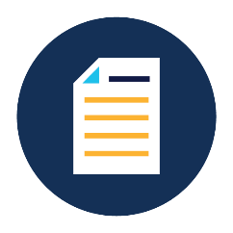
Documentation and Record Retention
► For more information: § 380.725
All training providers must retain specific records, including:
  Self-certifications by accepted driver-trainees for BTW training attesting that they will comply with U.S. Department of Transportation regulations, as well as State and/or local laws related to controlled substances and alcohol testing, age, medical certification, licensing, and driving record.
  A copy of the trainee's CLP or CDL.
  Instructor qualification documentation.
  Lesson plans for theory and BTW (range and public road) training curricula.
  Records of individual entry-level driver training assessments.
Records must be maintained for at least 3 years.
Notes:
Note: Retention of records. Training providers listed on the TPR must retain the records identified in paragraph (b) of this section for a minimum of three years from the date each required record is generated or received, unless a record, such as a BTW instructor's CDL, has expired or been canceled, in which case the most recent, valid CDL should be retained, if applicable. The provisions of this part do not affect a training provider's obligation to comply with any other local, State, or Federal requirements prescribing longer retention periods for any category of records described herein.

Slide 36
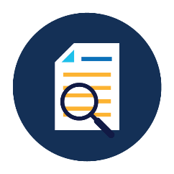
FMCSA Audits
► For more information: §§ 380.721, 380.723
Training providers must allow FMCSA or its authorized representative to audit their operations.
  If FMCSA determines that a training provider does not meet all applicable requirements, FMCSA may remove the training provider from the Registry.
  Any training conducted after a training provider’s removal date will be considered invalid.
  Training providers who wish to remain listed on the Registry may appeal FMCSA’s decision or take corrective action.

Slide 37
Maintaining Registration
► For more information: § 380.719
Within 30 days of a change Update your registration with any changes to key information, such as:
  Name, address, phone number.
  Type(s) of training offered.
  Training provider status.
  Change in State licensure, certification, or accreditation status.
Biennial update Confirm your TPR registration biennially, even if nothing has changed.
Notes:
For continued listing on the Registry, you must keep your information up to date. This means updating any information within 30 days of the change, and updating your listing every other year, even if nothing has changed.

Slide 38
Grounds for Removal
► For more information: § 380.721
FMCSA may remove a provider from the TPR based upon:
  Failing to comply with the requirements for continued TPR listing
  Denying access during an audit or investigation
  Material deficiencies in the program, operations, or eligibility
  Falsely claiming eligibility to provide training
  Evaluation of pass/fail rates for students of the providers based upon State testing scores
Removal by FMCSA means any training conducted after the removal date is invalid
On a case-by-case basis, FMCSA may retroactively invalidate previous training if the driver-trainee willingly engaged in fraud or other criminal behavior

Slide 39

How will your training provider submit driver training certification information?
Get Ready to Submit on February 7, 2022
  MANUAL SUBMISSION All training providers will be able to manually enter driver information using an online form.
  WEB SERVICES SUBMISSION Optional: Training providers with their own IT systems can set up a web interface to submit data via a TPR Web Service.
Notes:
Another thing that you want to be thinking about now is how you will to submit driver training records to the Training Provider Registry.
While most training providers will manually submit records by logging into the Registry and submitting each driver’s information into an online form, some training providers may submit data using a an automated web service. To use this second option, you will have to build a connection from your existing IT system to the Registry.

Slide 40

TPR Web Service
The TPR Web Service submission option may be a good fit for training providers that:
Anticipate submitting a significant number of driver training certifications on a regular basis.
Have an existing IT system to track driver training results.
Have an IT support team that can update your IT system to interface with TPR Web Service, per the technical specifications in the Web Services Development Handbook.
Learn more at https://tpr.fmcsa.dot.gov/DeveloperToolkit
Notes:
Building a connection to the Training Provider Registry to submit driver training information is not for everyone. Here are some things you may want to consider when deciding if the web services submission option is right for you:
Do you anticipate submitting a significant number of driver training certifications on a regular basis? We realize that “a significant number” is subjective, so you should take a look at your business needs and determine of you would see a return on the investment.
Do you have an existing IT system in which you track driving training results? This is a requirement of using the TPR Web Service interface. If you do not, manual entry is likely the best solution for you.
If you have your own IT system, do you have an IT support team that can make the necessary updates to your IT system, and maintain your system so that it can continue operating? If not, again, you will likely want to opt for the manual entry option.

Slide 41
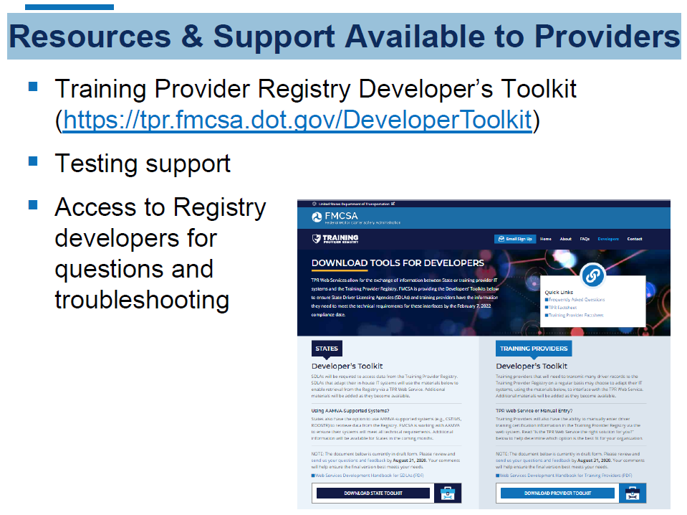
Resources & Support Available to Providers
Notes:
There are a lot of things that training providers can do now to be ready when TPR registration opens this summer.
First, you’ll want to review your curricula, vehicles, documentation, and processes to make sure you meet the ELDT requirements that we just talked through. During TPR registration, is when you must self-certify that you meet the requirements.
While you are not required to register with FMCSA until the February 7, 2022 compliance date, registering early means that your information will be available to drivers who start searching for training providers when the public search opens this fall.

Slide 42
Training Provider registration now available
Get Ready to Register
  Ensure your curricula, documentation, vehicles, etc. meet the minimum ELDT standards.
  When you register, you must self-certify that you comply with all applicable ELDT requirements.
  For a complete list of training provider requirements, visit 49 CFR part 380 subparts F and G and appendices A through E.
Notes:
There are a lot of things that training providers can do now to be ready when TPR registration opens this summer.
First, you’ll want to review your curricula, vehicles, documentation, and processes to make sure you meet the ELDT requirements that we just talked through. During TPR registration, is when you must self-certify that you meet the requirements.
While you are not required to register with FMCSA until the February 7, 2022 compliance date, registering early means that your information will be available to drivers who start searching for training providers when the public search opens this fall.

Slide 43
Countdown to ELDT

Slide 44

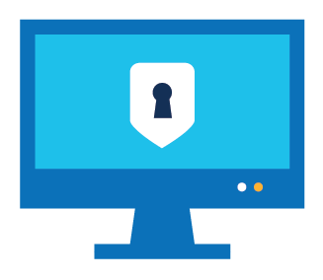
Training Provider Registry Timeline
Summer 2021
Fall 2021
February 7, 2022
Training provider registration begins
List of training providers publicly available on the Training Provider Registry website
ELDT compliance date
Training providers begin
submitting training certification information
States begin
verifying driver training certification information
Notes:
This slide provide a quick reminder of some of the key dates for implementation of the Training Provider Registry.
This summer, training providers can begin the registration process, so that your listing is current in the fall when public search of the registry begins and prospective students may begin looking for authorized entry-level driver training providers.
But, you do not need to begin submitting driver certification information to the Training Provider Registry until the February 7, 2022 ELDT compliance date for any drivers subject to the ELDT.

Slide 45
Resources from FMCSA
Visit the TPR website: https://tpr.fmcsa.dot.gov
  Sign up for email updates from FMCSA
  Find answers to frequently asked questions
  Access developer materials to help you build a connection to the TPR Web Service
Driver/General Information
Training Provider Registry Factsheet ELDT Overview Presentation
Materials for Training Providers
Training Provider Factsheet Countdown to ELDT Checklist ELDT Curricula Summary

Slide 46

Q&A

Slide 47


Questions? Contact Us
To learn more about ELDT and the Training Provider Registry, visit:
https://tpr.fmcsa.dot.gov
Illinois Division Office
Dan Meyer
Division Administrator
dan.meyer@dot.gov
You can also contact FMCSA’s TPR Team:
https://tpr.fmcsa.dot.gov/#contact

